Slide 1
Lecture №2
Cell organelles. Cell wall: structure, purpose, biology. Membrane: structure, purpose, biology, biochemical aspects. Membrane bound and Non-membrane-bound organelles

Slide 2
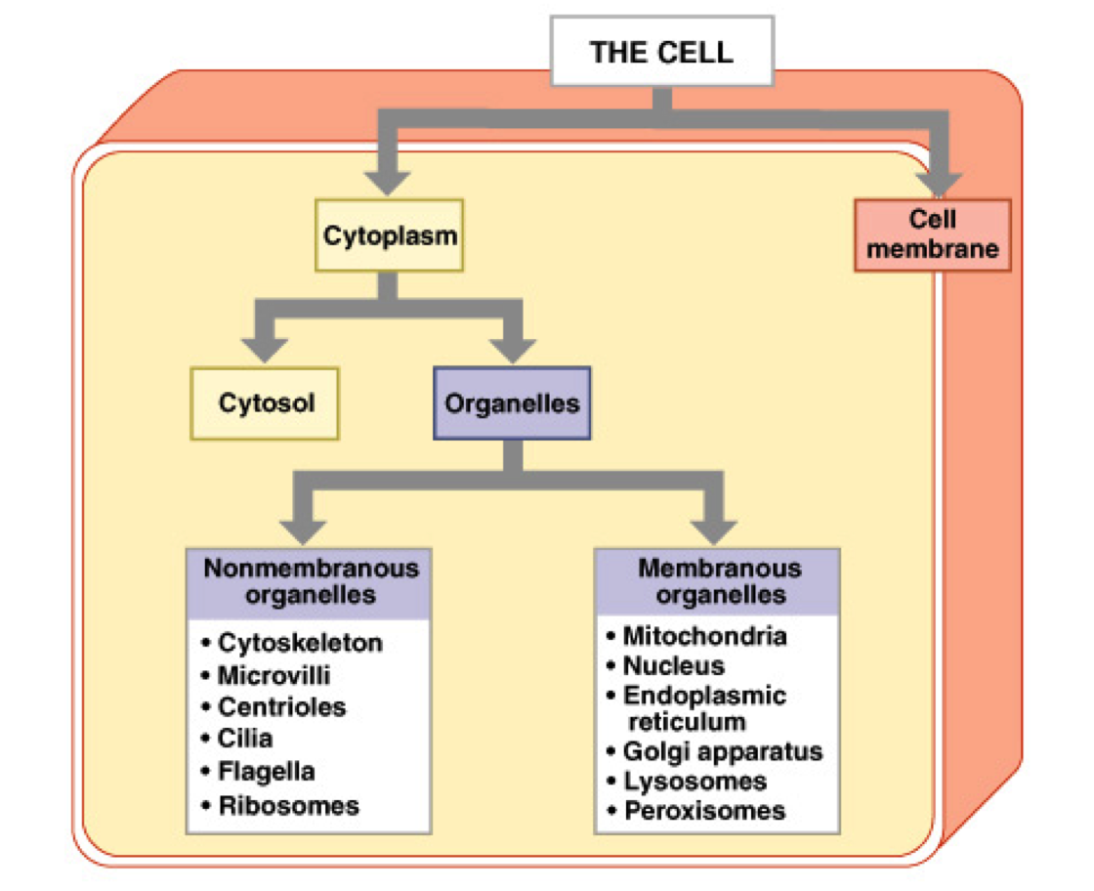
Cell organelles

Slide 3
Plasma membrane
is primarily composed of protein and lipid, although carbohydrate is often present in association with protein (as glycoprotein) or lipids (as glycolipid). However, the relative proportions of protein and lipid vary considerably in membranes from different sources. Enzymes are also found in plasma membranes which play an important role in ionic exchange. Besides, salt and water are also present. The arrangement of lipids and proteins molecules is explained through various theories.
Every cell, prokaryotic or eukaryotic, is surrounded by a thin layer of outermost boundary called the plasma membrane or cell membrane or plasma - lemma. The plasma membrane is a discrete structure and is remarkably complex in its molecular organization. It maintains the difference of the internal environment of the cell from its external environment by controlling the entrance and exit of the molecules and ions. It checks the loss of metabolically useful substances and encourages the release of toxic metabolic byproducts of the cell. Thus, it functions as semi-permeable or selectively permeable membrane.

Slide 4
The plasma membrane constitutes the outermost boundary of the cell and it is remarkably complex in its molecular organization. It is composed of almost equal parts of proteins and lipids. It allows only selected ions and macromolecules to enter or leave the cell, thus it functions as a semi permeable membrane.
Ultra structure of plasma membrane may be of symmetrical or asymmetrical molecular structure in nature. Plasma membrane is a tripartite structure in both of the above types, the difference lies in the thickness of the three layers.
In symmetrical molecular structure all the three layers, the outer and inner along with the middle layer are of 25Å thickness each having total thickness of 75Å. While in asymmetrical structure the inner component is of 35Å to 40Å thickness, the outer component is of 25Å thick and the central dielectronic layer is 30Å wide, thus total thickness becomes 90 - 95Å.

Slide 5
In symmetrical molecular structure all the three layers, the outer and inner along with the middle layer are of 25Å thickness each having total thickness of 75Å.
While in asymmetrical structure the inner component is of 35Å to 40Å thickness, the outer component is of 25Å thick and the central dielectronic layer is 30Å wide, thus total thickness becomes 90 - 95Å.

Slide 6
Lamella model of plasma membrane is consisted of a double layer of lipid molecules arranged radially with their hydrophobic hydrocarbon chains towards each other and with their respective polar groups arranged outwardly and inwardly. The double layer of lipids is sandwiched between two continuous layers of proteins. In this model the lipids are arranged in a bilayer in which proteins are embedded as peripheral or integral. The proteins varied in size and dissolved to varying degrees in the lipid matrix, diffuse laterally in the plane of membranes and the entire structure is hence dynamic.

Slide 8
Chemical Composition of the Plasma Membrane
LIPIDS
The plasma membrane contains about 20 to 79% lipids mainly of three types like phospholipids, cholesterol and glycolipids. The phospholipids which make up between 55% and 75% of the total lipid content, consists chiefly of lecithin and cephalin. . The remainder consists of sphingolipids (with an amino group) and glycolipid conjugates with carbohydrates. Phospholipids derived from glycerol are called phosphoglycerides. The outer layer of phospholipids consists mainly of lecithin and sphingomyeline, while the inner layer is composed mainly of phosphatidyl ethanolamine and phosphatidyl serine (both are phosphoglycerides). The glycolipids (sugar containing lipids) are mainly in the outer half of the bilayer.

Slide 9
Membrane lipids are amphipathic molecules. They contain both a hydrophilic and hydrophobic parts.
Hydrophilic unit is also called the polar head groups, is represented by a circle and their hydrocarbon tails are by straight or wavy lines. Polar head groups have affinity for water, whereas their accomplished by forming a micelle, in which polar head groups are on the surface and hydrocarbon tails are directed inside.

Slide 10
Another arrangement of lipid molecule in a also called a lipid bilayer. Phospholipids and glycolipids are key membrane constituents of bimolecular sheets. Hydrophobic interactions are the major driving force for the formation of lipid bilayer. The lipid bilayer of the membrane is interrupted only by the proteins that traverse it. This bilayer consists primarily of:
Neutral Phospholipids and cholesterol
Acidic phospholipids

Slide 11
Proteins
Proteins are the main component of plasma membrane. Myelin sheath (membrane surrounding some nerve axons) is composed of about 80% lipids and 20% protein and presence of lipid makes myelin an excellent insulator.
Eukaryotes membrane which serves primarily as permeability barriers possesses about 50% proteins and 50% lipid. Plasma membrane that are actively involved in energy transfer, such as inner membrane of mitochondria, chloroplasts and membranes of aerobic prokaryotes have large amounts of proteins i.e. about 75%. They not only provide mechanical support but also act as carriers or channels, serving for transport. In addition numerous enzymes, antigens and various kinds of receptor molecules are present in plasma membranes. Membrane proteins are classified as integral (intrinsic) or peripheral (extrinsic) according to the degree of their association with the membrane.

Slide 12
Peripheral Proteins: They are also called extrinsic proteins associated with membrane surface.They are bound to the surface by electrostatic and hydrogen bond interactions. They form outer and inner layers of the lipid bilayer of plasma membrane. Common examples are cytochrome-C found in mitochondria, acetyl cholinesterase in membrane and spectrin found in erythrocytes.
Integral Proteins: These proteins penetrate the lipid layer wholly or partially and represent more than 70% of the two protein types. Their polar ends protrude from the membrane surface while non-polar regions are embedded in the interior of the membrane. Usually they are insoluble in water solutions and can be separate them from the membrane by detergents or organic solvents. The major integral proteins span the thickness of the membrane and have a small amount of carbohydrates on the pole at the outer surface. This protein appears to be involved in the diffusion of anions across the membrane. Integral proteins may be attached to the oligosaccharides to form glycoprotein or to phospholipid to form lipoproteins or proteolipids. Common intrinsic proteins are rhodopsin found in retinal rod cells and cytochrome oxidase found in mitochondrial membranes.

Slide 13
Enzymes
About 30 enzymes have been found in various membranes.
Those most constantly found are 5'-nucleotidase, Na+-K+ activated ATPase, alkaline phosphatase, adenylcyclase, RNAse and acid phosphomonoestrase.
Na+-K+ activated Mg+ ATPase plays an important role in the ionic exchange and may also act as carrier protein or permease across the plasma membrane. Some enzymes have a preferential localization. For example, alkaline phosphatase and ATPase are more abundant in bile capillaries, while disaccharides are present in microvilli of the intestine. Enzymes are asymmetrically distributed, for example in the outer surface of erythrocytes there are acetylcholinestrase, nicotinamide adenine dinucleotidase and Na+-K+ ATPase.

Slide 14
Carbohydrates
The membranes of eukaryotic cells usually contain 2% to 10 % carbohydrates in the form of glycolipids and glycoproteins. Hexose, hexosamine, fucose and sialic acid are the commonest carbohydrates found in the membrane. Plasma membranes of neuronal surface contain gangliosides and are probably involved in the ion transfers. The distribution of oligosaccharides is also highly asymmetrical

Slide 15
Salts and water
They are also present in cell membranes. Water in cell membranes forms parts of membrane structure as it does in all cell constituents.

Slide 16
Functions of Plasms membrane
It maintains the individuality and form of the cell.
It keeps the cell contents in place and distinct from the environmental materials.
It protects the cell from injury.
It regulates the flow of materials into and out of the cell to maintain the concentration and kinds of molecules and ions in the cell. A cell remains alive as long as the cell membrane is able to determine which materials should enter or leave the cell.
It forms organelles within the cytoplasm.
Its junctions keep the cells together.
It’s infolds help in the intake of materials by endocytosis (pinocytosis and phagocytosis).
It’s out folds (microvilli) increase the surface area for absorption of nutrients. The out folds also form protective sheaths around cilia and flagella.

Slide 17
Its receptor molecules permit flow of information into the cell.
Its oligosaccharide molecule helps in recognizing self from non-self.
By controlling flow of material and information into the cell, the plasma membrane makes metabolism possible.
It controls cellular interactions necessary for tissue formation and defense against microbes.
It helps certain cells in movement by forming pseudopodia as in Amoeba and leucocytes.

